Slide 1
Data Engineering
Introduction and ETL

Slide 2
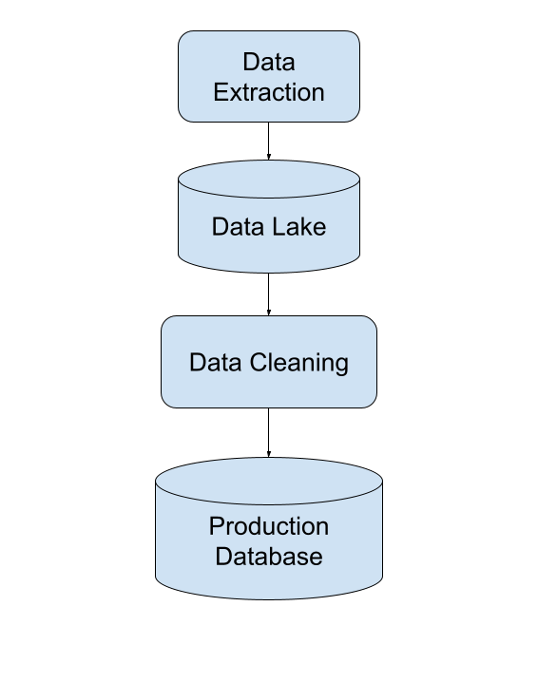
What do Data Engineers do?
Provide organized, consistent data flow to enable data-driven work
Extracting the Data
Cleaning the Data
Normalize the Data
Make the Data Consistent
Apply Feature Engineering
Dealing with missing Data
Make the Data available for the team

Slide 3
Extracting the Data
Downloading the data from its source
We can get the data from an existing Database
We can get the data from an API
We can get the data from a webpage using Webscraping:
Requests
Selenium
Beautiful Soup
We will see this in the ‘Data Collection’ module

Slide 4
Cleaning the Data
Your data should be consistent and ready for consumption
We can clean the data by making every variable have the same data type
We can clean the data by ‘filling’ (imputing) missing data
We can clean the data by removing outliers
We can create new variables applying feature engineering. This might be an iterative process
We will mainly use pandas
We will see this in the ‘Data Transformation’ module

Slide 5
Making the Data available
The cleaned data will be accessible by other teammates
We can load the data into a Data Lake
We can load the data into some Datasets
We can load the data into a Database:
PostgreSQL
AWS RDS
AWS S3
We will see this in the ‘SQL’ and ‘Cloud Basics’ modules

Slide 6
ETL
Extract, Transformation and Loading
The steps mentioned up to now constitute ETL: the bread and butter of a Data Engineer
The steps are usually performed in tandem
The steps can be performed in batches or streamed
The steps can be used for large amounts of data (Big Data)
We will see more on this using the Apache Stack

